Slide 1
Notes:
One World Week creation reflection with ideas for commitment pledges.
We offer these slides to support Christian events for One World Week. Please feel free to adapt as fits with your own needs or add with other of the many resources already available.
The slides might be useful for a stand alone event or as an opening reflection with a speaker or maybe you could show one of the many short films explaining about the effects of climate
Notes on slides 2 and 16

Slide 2
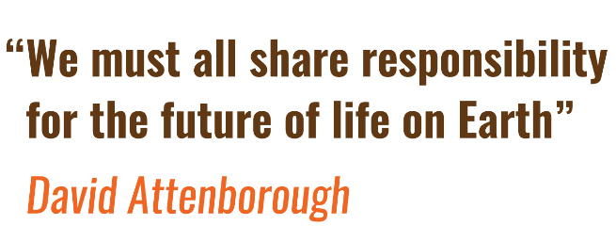
One World Week 2019
Seeks to engage us in addressing:
How INTERCONNECTED climate and nature are with our lifestyles
Our RESPONSIBILITY to secure a future for our children
And the URGENCY to act now
https://www.youtube.com/watch?v=zq4eCQCgQw8
Notes:
Each year One World Week offers the opportunity to take part in a local event about global issues aimed at building links and celebrating living in a shared world. Its aim is to offer inspiration and hope to encourage people to act to build a just, more equal, inclusive and peaceful world. This year the theme is safeguarding the environment for future generations.
We all now have experience of how the climate is changing, of the damage to the natural systems which sustain us; plants, animals and humans.
This One World Week we are called to address:
How interconnected climate and nature are with our lifestyles
Our responsibility to secure a future for our children
The urgency to act now.
To expand n this slide more information on one world week introduction
As people of faith our starting point to address major concerns is, of course, in prayer, in listening, praising and petitioning the Lord to guide us to right action. Our contribution is not always large but each of us has a part to play in caring for this one world.
So, we offer this short reflection on the creation story and encourage everyone afterwards to think about the commitments and changes you can make individually, as a faith community and as part of the wider community.
Act now and together we will make a difference.
Before the prayer you may wish to show short film or listen to Greta Thrunberg 1975 song https://www.youtube.com/watch?v=zq4eCQCgQw8
listen and pray together

Slide 3
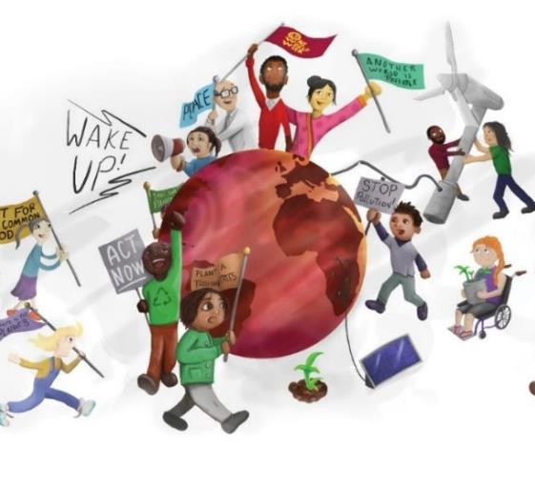
Reflection Prayers and Readings based on the Creation story “Praise and glory to the Lord who in the beginning created the universe.”

Slide 4
Light and Dark
God commanded, “Let there be light”—and light appeared. God saw that it was good.
Then he separated the light from the darkness, and he named the light “Day” and the darkness “Night.”
Illustrations of creation Thanks to Galih Reza Artist.

Slide 5
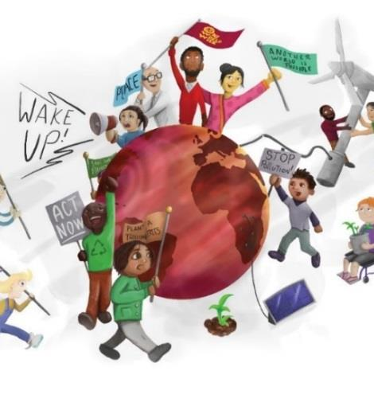
Let Us Pray:
Praise and glory to the Lord for giving us day to work and night to rest.
Guide us to make good use of our time to know when to work and when to rest.
One world created, shared by all! Sustain us to work together as good stewards of the earth, for Now is the Time to Act

Slide 6
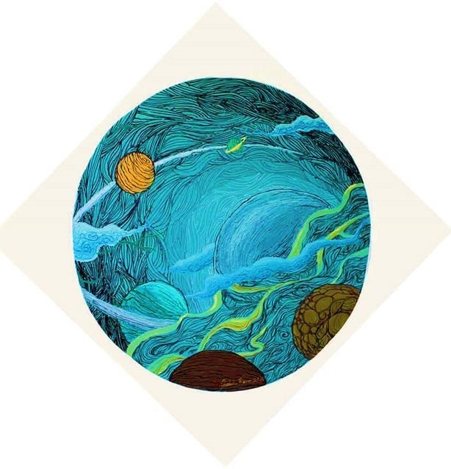
Sky, Earth and Sea
God commanded, “Let there be a dome to divide the water and to keep it in two separate places”—and it was done.
So, God made a dome, and it separated the water under it from the water above it. He named the dome “Sky.”
God commanded, “Let the water below the sky come together in one place, so that the land will appear”—and it was done.
He named the land “Earth,” and the water which had come together he named “Sea.” And God saw that it was good.

Slide 7
Let Us Pray:
Praise and glory to the Lord for giving us the sky, the sea and the earth.
Guide us to respect the wonders of this place as we journey through this life.
One world created, shared by all! Sustain us to work together as good stewards of the earth, for Now is the Time to Act

Slide 8
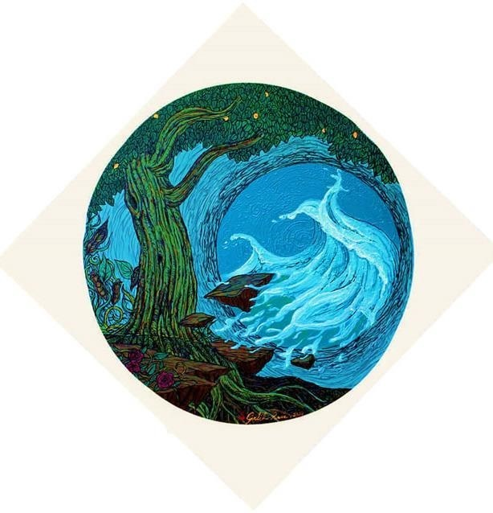
Plants
God commanded, “Let the earth produce all kinds of plants, those that bear grain and those that bear fruit”—and it was done. So, the earth produced all kinds of plants, and God saw that it was good.

Slide 9
Let Us Pray:
Praise and glory to the Lord for giving us an amazing number of plants and trees, for food, for beauty and to produce oxygen for us all to breath.
Guide us to a better understanding of how to be better gardeners, farmers, environmentalists and conservationists.
One world created, shared by all! Sustain us to work together as good stewards of the earth, for Now is the Time to Act

Slide 10
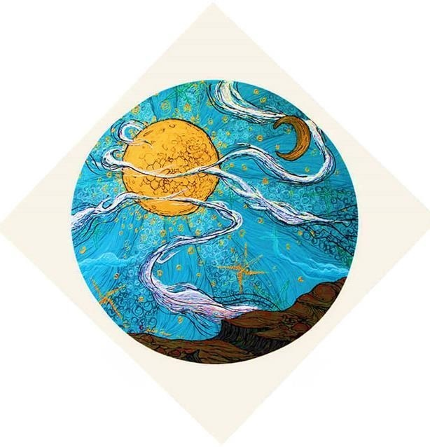
Sun, moon and stars
God commanded, “Let lights appear in the sky to separate day from night and to show the time when days, years, and religious festivals begin; they will shine in the sky to give light to the earth”—and it was done.
So, God made the two larger lights, the sun to rule over the day and the moon to rule over the night; he also made the stars.
He placed the lights in the sky to shine on the earth, to rule over the day and the night, and to separate light from darkness. And God saw that it was good.

Slide 11
Let Us Pray:
Praise and glory to the Lord for giving us the sun, the moon and the stars to light our way and creating an atmosphere where life can thrive.
Guide us to be more courageous in speaking out against those things that damage the world.
One world created, shared by all! Sustain us to work together as good stewards of the earth, for Now is the Time to Act

Slide 12
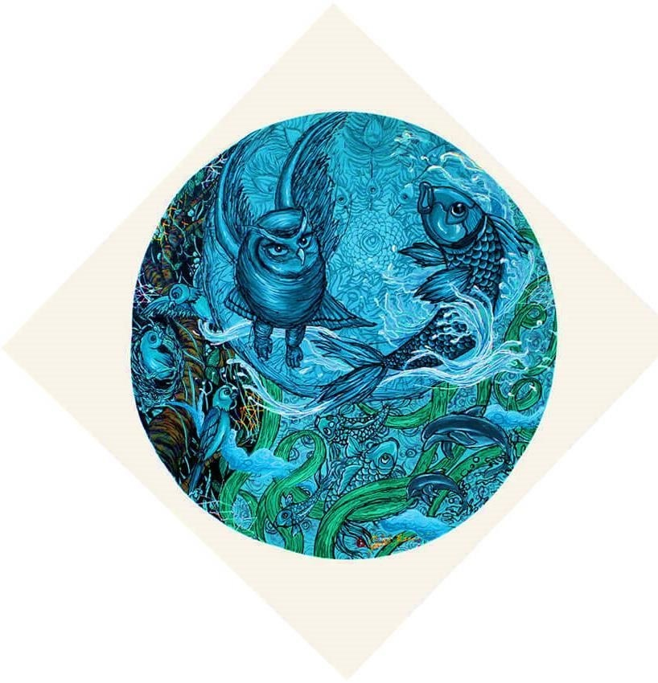
Fish, birds and animals
God commanded, “Let the water be filled with many kinds of living beings, and let the air be filled with birds.”
So, God created the great sea monsters, all kinds of creatures that live in the water, and all kinds of birds. And God saw that it was good.
God commanded, “Let the earth produce all kinds of animal life: domestic and wild, large and small”—and it was done. So, God made them all, and saw they were good.

Slide 13
Let Us Pray:
Praise and glory to the Lord for the marvelous diversity of creatures.
Grant us the wisdom to deepen our understanding of the biodiversity and interdependence of all living things.
One world created, shared by all! Sustain us to work together as good stewards of the earth, for Now is the Time to Act

Slide 14
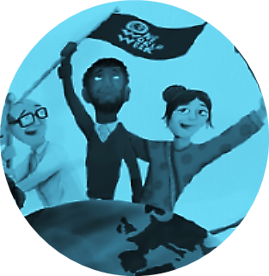
Humankind
Then God said, “And now we will make human beings; they will be like us and resemble us. They will have stewardship over the fish, the birds, and all animals, domestic and wild, large and small.”
So, God created human beings, making them to be like himself. God looked at everything he had made and saw that it was good.

Slide 15
Let us pray:
Praise and glory to the Lord our creator who knows and blesses everyone of us.
Guide us as we recognise our responsibility to each play a part in the flourishing of all creation, nature and humankind.
One world created, shared by all! Sustain us to work together as good stewards of the earth, for Now is the Time to Act

Slide 16
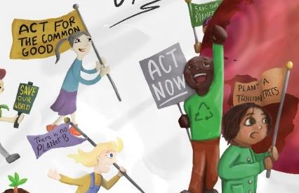
Commitment Pledges
For our ONE WORLD will you commit to one Act:
To a lifestyle change
To better care for our neighbours
To secure a future for all creation
As CLIMATE CHANGES EVERYTHING Act:
Individually
As a faith community
In the wider world
NOW IS THE TIME TO ACT
Notes:
Having reflected on the wonders of creation. This might be the time for a speaker if you have one, talk about a local project that people might like to get involved in or maybe if you are having stalls just include a pledge board before people leave.
We propose though that as the theme is about Now is the Time to Act that giving people a chance to get practical and thinking about what they might actually do, make a commitment is vital. What is needed is both small lifestyle changes, which if everyone does something will build up, bigger changes and global solutions.
Here it is proposed that you think about responses in three ways(1) in our own consumerism, how can our lifestyle be simplified, secondly (2)as it is clear that it is the poor that are the most effective by climate change how can we respond for the common good of all and thirdly (3)think about all creation and a sustainable future .
The following three slides give some ideas to get people start discussing. You can decide which or all your community wish to look at – (1)are you asking people to make a personal response or would you like to come up with ideas to work on together(2) as a faith community or finally what at the bigger responses needed global decisions(3) and how can we impact into these
A display of map of the world or a tree works well for pledges, give people post its and everyone writes their commitment and sticks it up in public, a way to see impact together and a reminder to keep going.

Slide 17
Individually I commit to…
Act to change my life style | Reduce - buy less, give away stuff no longer useful, go for a renewable energy tariff, travel by public transport. Go electric – bike or car, eat less meat, buy local, walk more Reuse – up cycle, pass things on, buy second hand; Recycle, take my own cup, use cloth bags, buy recycled paper.
Act to better care for my neighbour | Dispose of goods on local freecycle site or charity shop. Help at local repair café. Get involved in local visiting group, or group that helps with gardening. Start a walking or cycling group, share lifts in my car.
Act to secure a better future for all creation | Cultivate plants for insects, bees and birds to eat and live. Become a tree warden. Volunteer for litter picking or local environmental charity. Use the car less. Look for ideas in “L is for lifestyle” by Ruth Valerio, recently updated. Join Green Christians https://greenchristian.org.uk/

Slide 18
As a faith community We will commit to….
Act to change our life Style | Change to renewable energy tariff, use low energy products, highlight events like Walk to Church Sunday, use less paper, use real cups when possible and otherwise recyclable. Turn heating down 1 degree
Act to better care for our neighbour | Support a charity locally and overseas that encourages tree planting, sustainable farming, Fairtrade, education. Collect recyclables for charity. Invite neighbours in, offer hospitality, adapt for disability access. Bring people to our worship. Use ethically sourced products, Fairtrade teas and coffees.
Act to secure a better future for all creation | Green any land around our place of worship. Try to create less waste, less plastic. Use electronic mailing where possible. Look at improving your energy efficiency. Use cleaning products without harmful chemicals Look at eco church awards: https://ecochurch.arocha.org.uk/

Slide 19
In the wider world – I will support a commitment to:
Act to change my life Style | Support my local community with greening projects, litter picks, tree planting, recycling schemes. Lobby for national changes like green and affordable transport. Supporting cycling and foot path routes.
Act to better care for my neighbour | Get involved in civil society -serve as a local councillor, volunteer in local neighbourhood group, lobby councillors and your MP. Look at what I could do build community in my own street. Campaign and fund raise for a global charity.
Act to secure a better future for all creation | Support petitions asking government to bring in legislation to use less fossil fuel ( Christian Aid ) Help a nature group. Speak up.

Slide 20
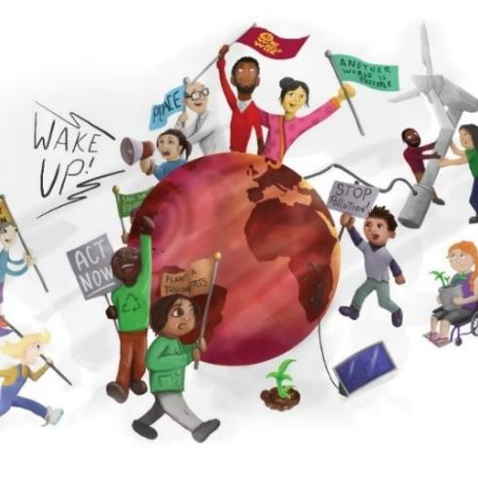
Blessing
Lord of all creation
We thank you for all the wonders of the universe. We praise you for this opportunity to come together this day as part of the family of all humankind.
May our prayers and actions help to build a just , more equal, inclusive and peaceful world that safeguards environmental resources now and for future generations.
May the Lord Bless us and all our endeavours in committing to these pledges to act now ……

Slide 21
CREDITS
OWW is extremely grateful to:
Maureen Thompson for ideas, text and design
Galih Reza, Artist, for the Illustrations of Creation
Webber Design for the OWW graphics

